Slide 1
Update on SWI/SGD model building
Sept 12, 2018

Slide 2
Outline
Objective
Model’s current status
Future implementations
Questions/problems with the model

Slide 3
Objective
Investigate the cause of spatially heterogeneous SGD flux and salinity
Connect a theoretical model of SGD to real field measurements to see if our model is capturing realistic patterns
Can our current understanding of SWI mechanisms explain the variability we see?

Slide 4
Objective
Flux (cm/d)
Flux Saltwater (cm/d)
EC
(mS/cm)
Flux Freshwater (cm/d)

Slide 5
Model’s current status
SEAWAT model being built as sandbox to explore SWI mechanisms and compare to field measurements
SEAWAT pre/post-processing managed through flopy
Currently available:
K field, porosity field, boundary condition values easily switched
Can be a 2D or 3D simulation
Can be steady state, transient, or both
The model measures flux and salinity of outflow at the ocean boundary
I have written scripts to run PEST and optimize the K field based on measurements

Slide 6
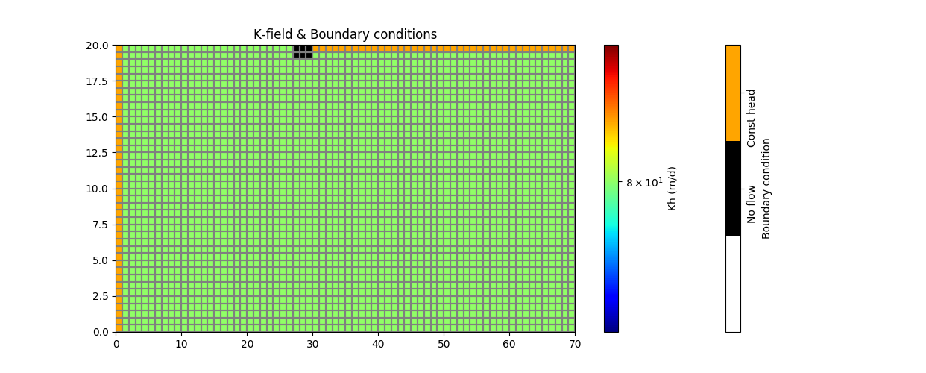
2D Model—homogenous K field 20 lay x 1 row x 70 col
Ocean
Inland

Slide 7
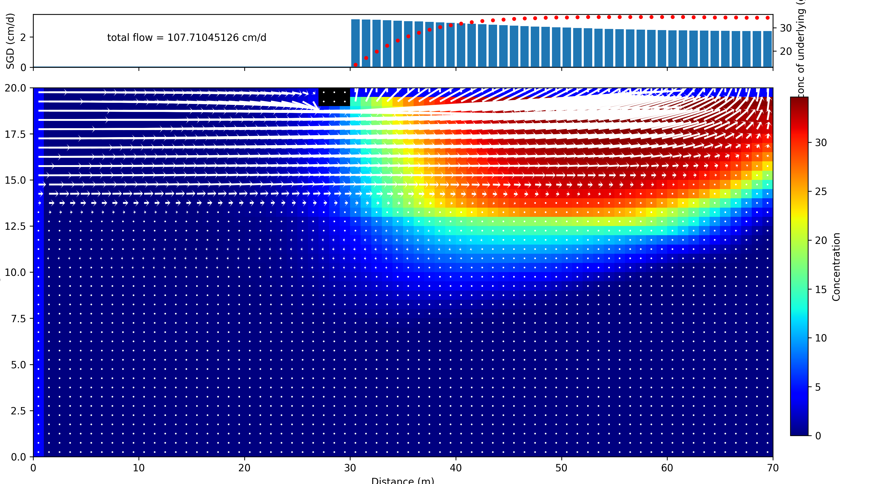
Model concentration field--homogenous
Outflow at each ocean node
(blue bar)
Salt conc. below each ocean node
(red)

Slide 8
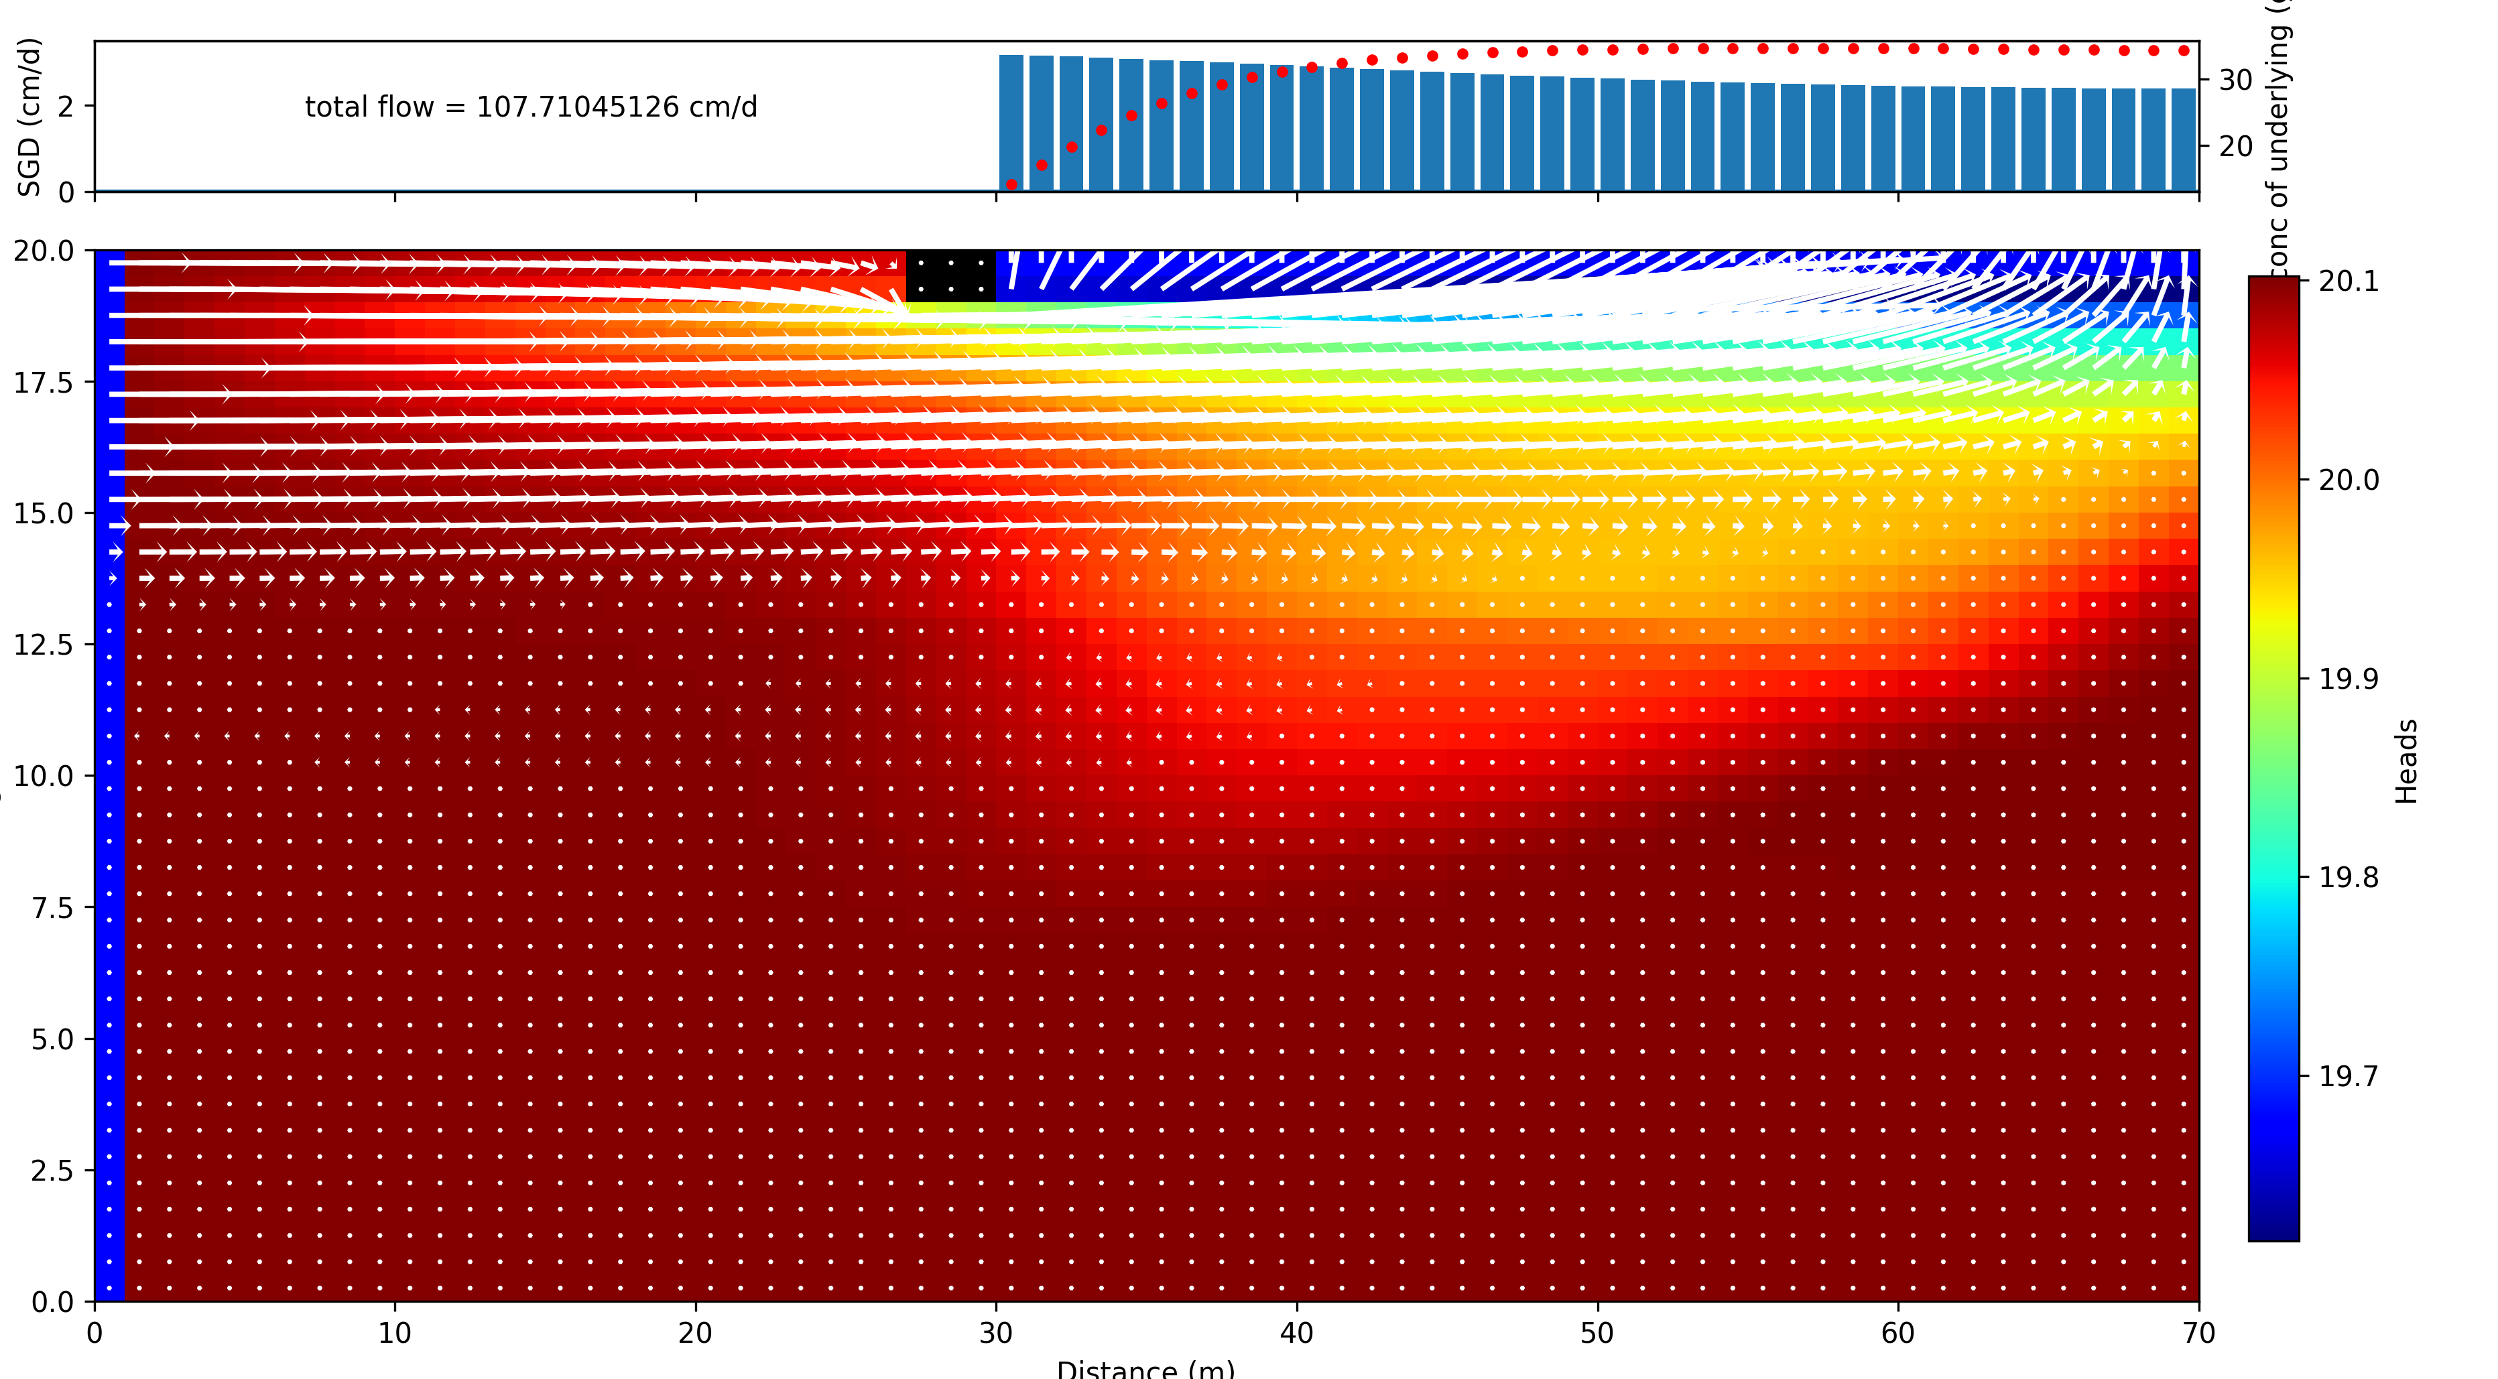
Model head field—homogenous

Slide 9
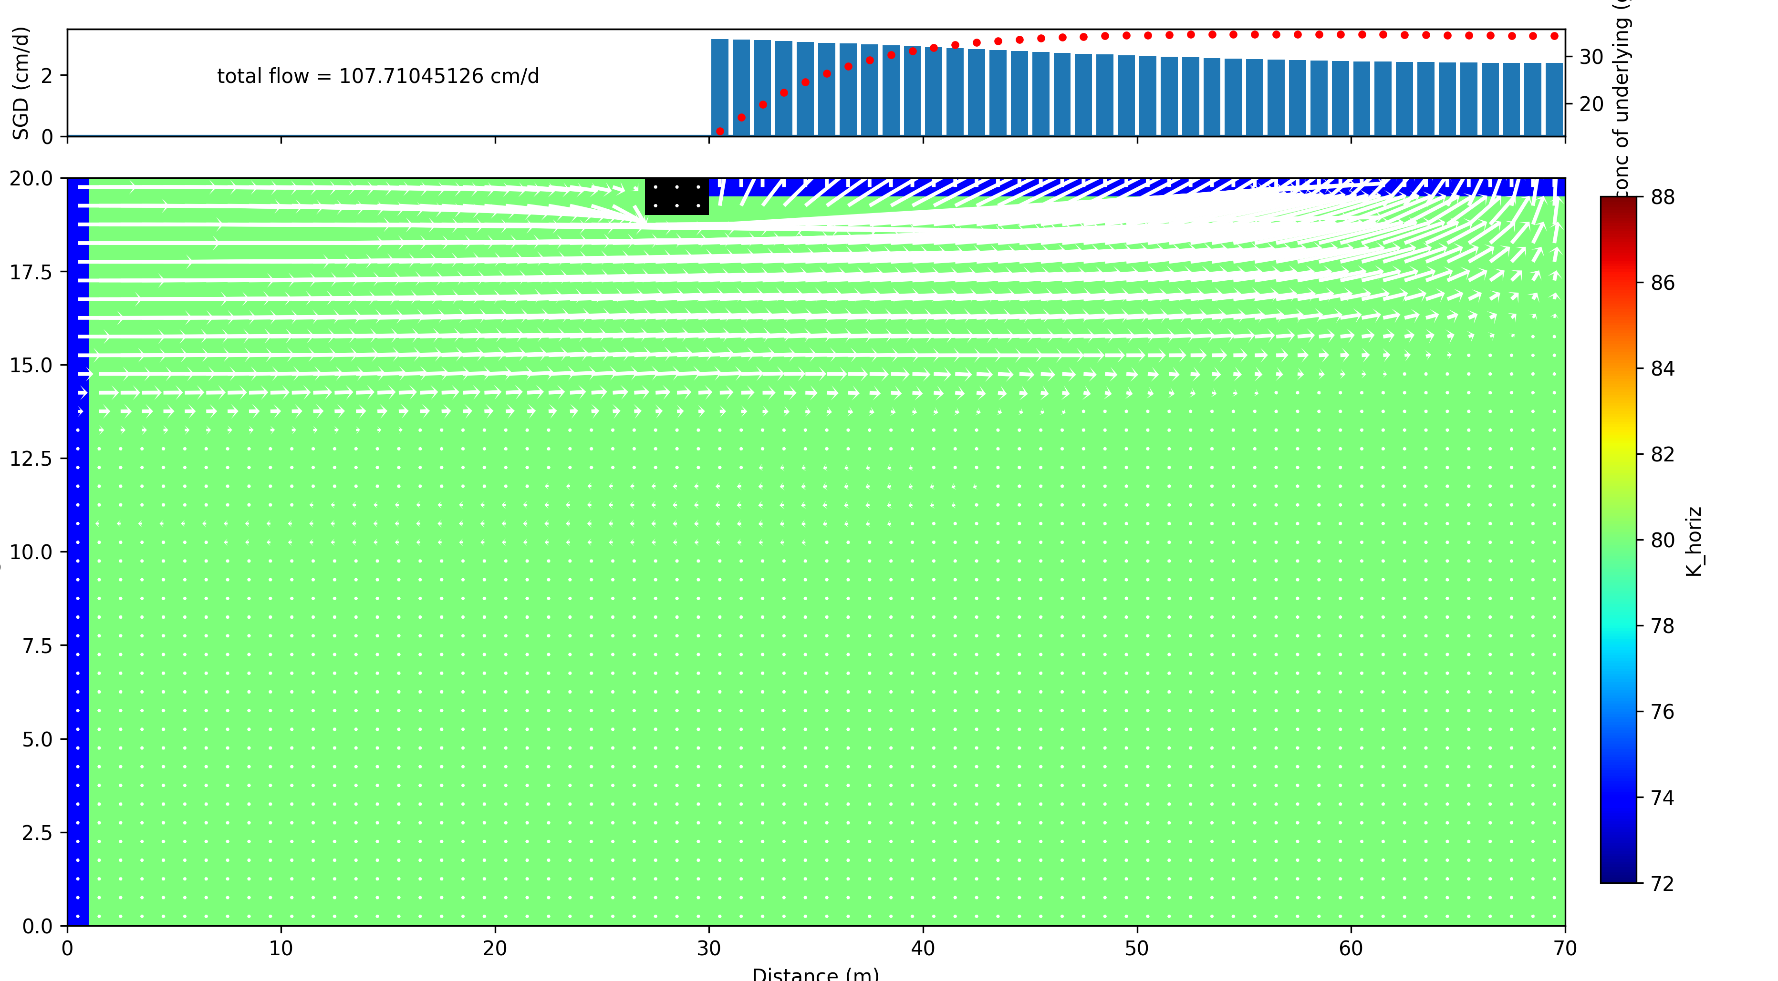
Model K field--homogenous

Slide 10
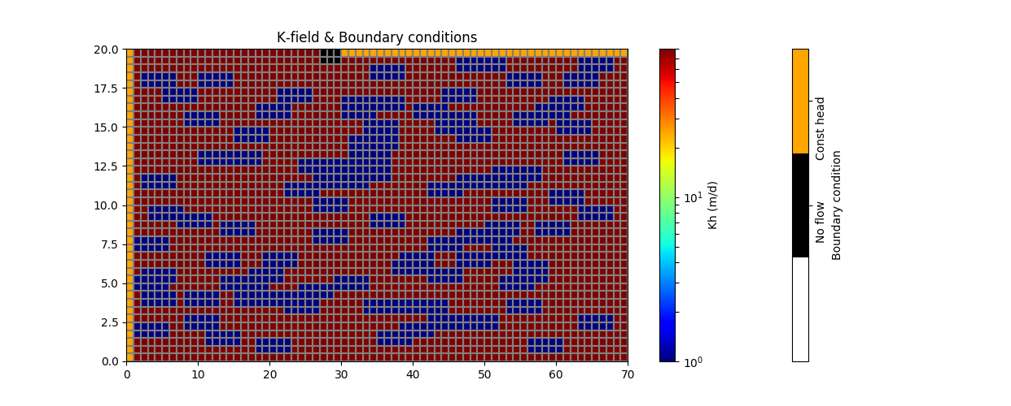
2D Model— heterogeneous random clay blocks

Slide 11
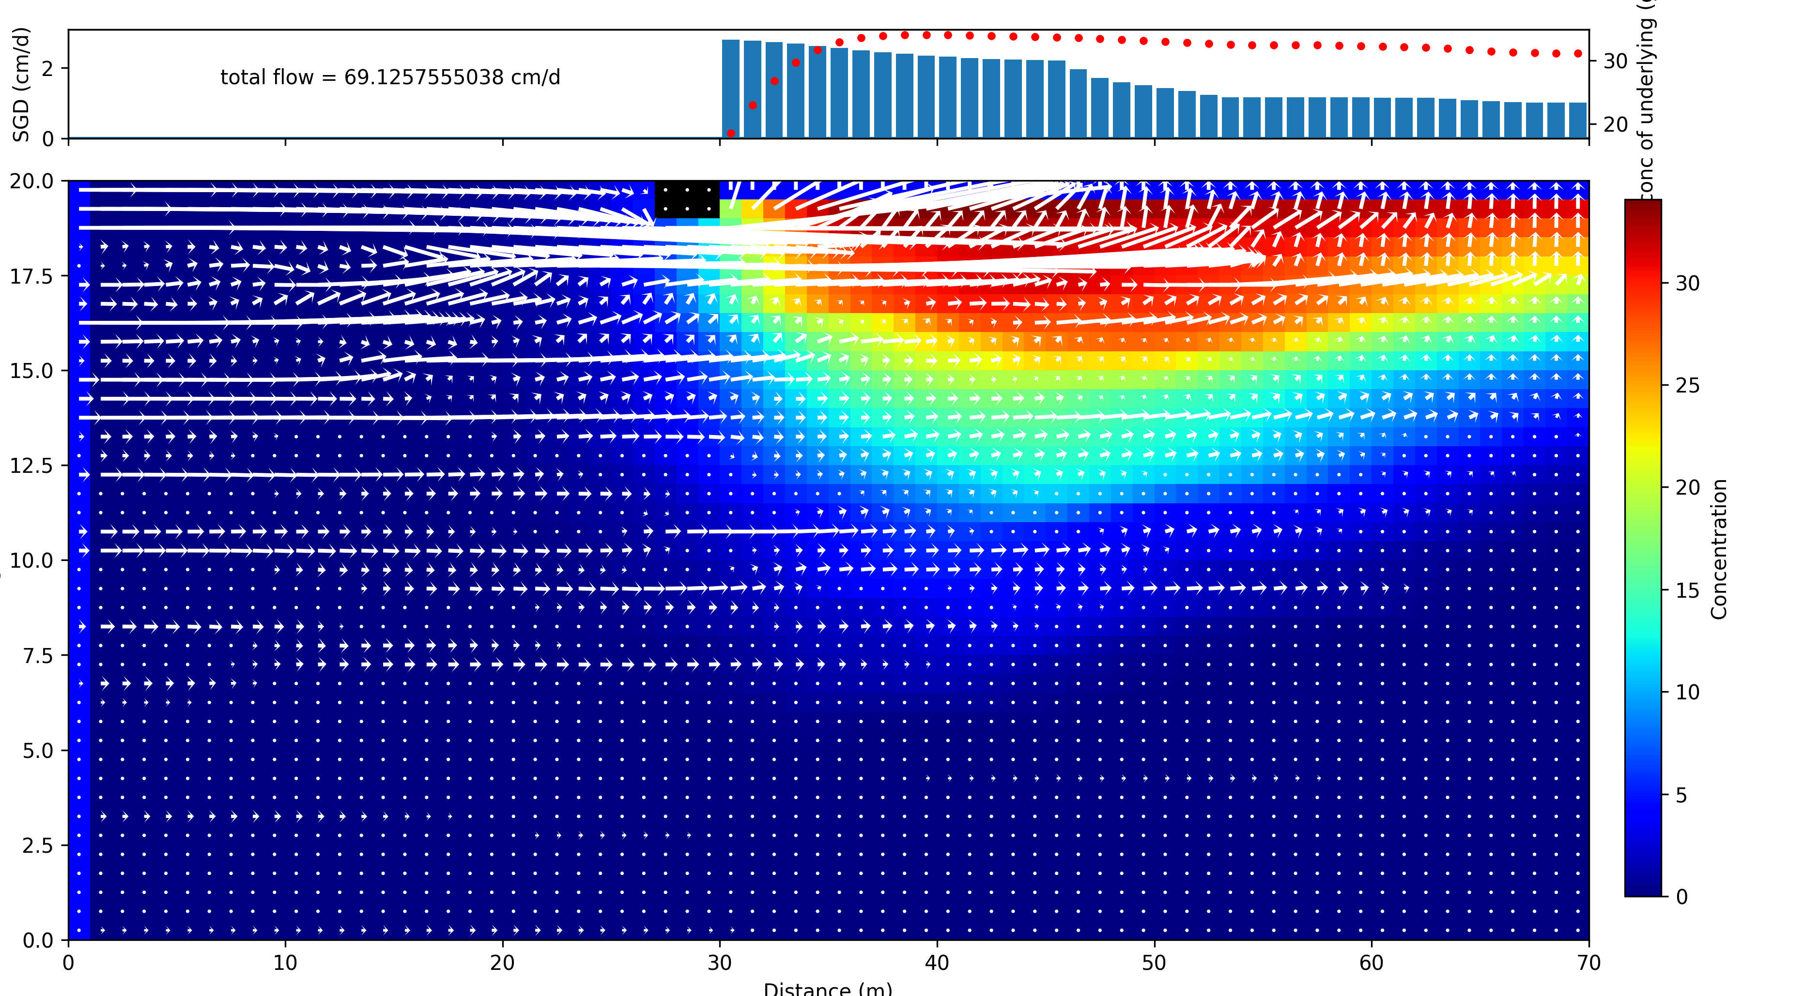
Model concentration field—heterogeneous

Slide 12
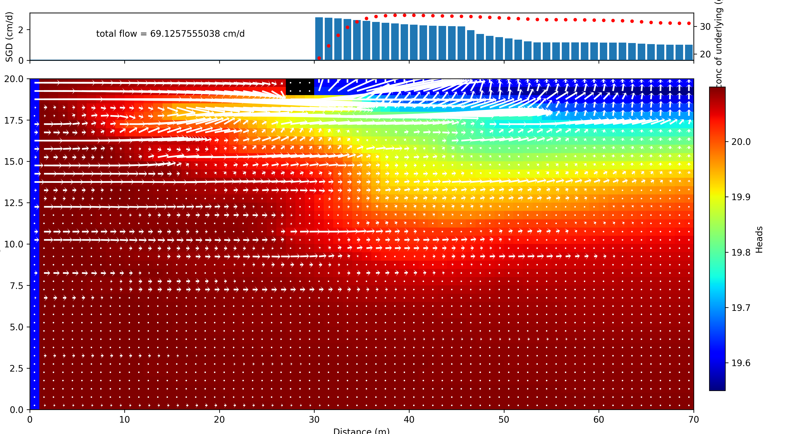
Model head field—heterogeneous

Slide 13
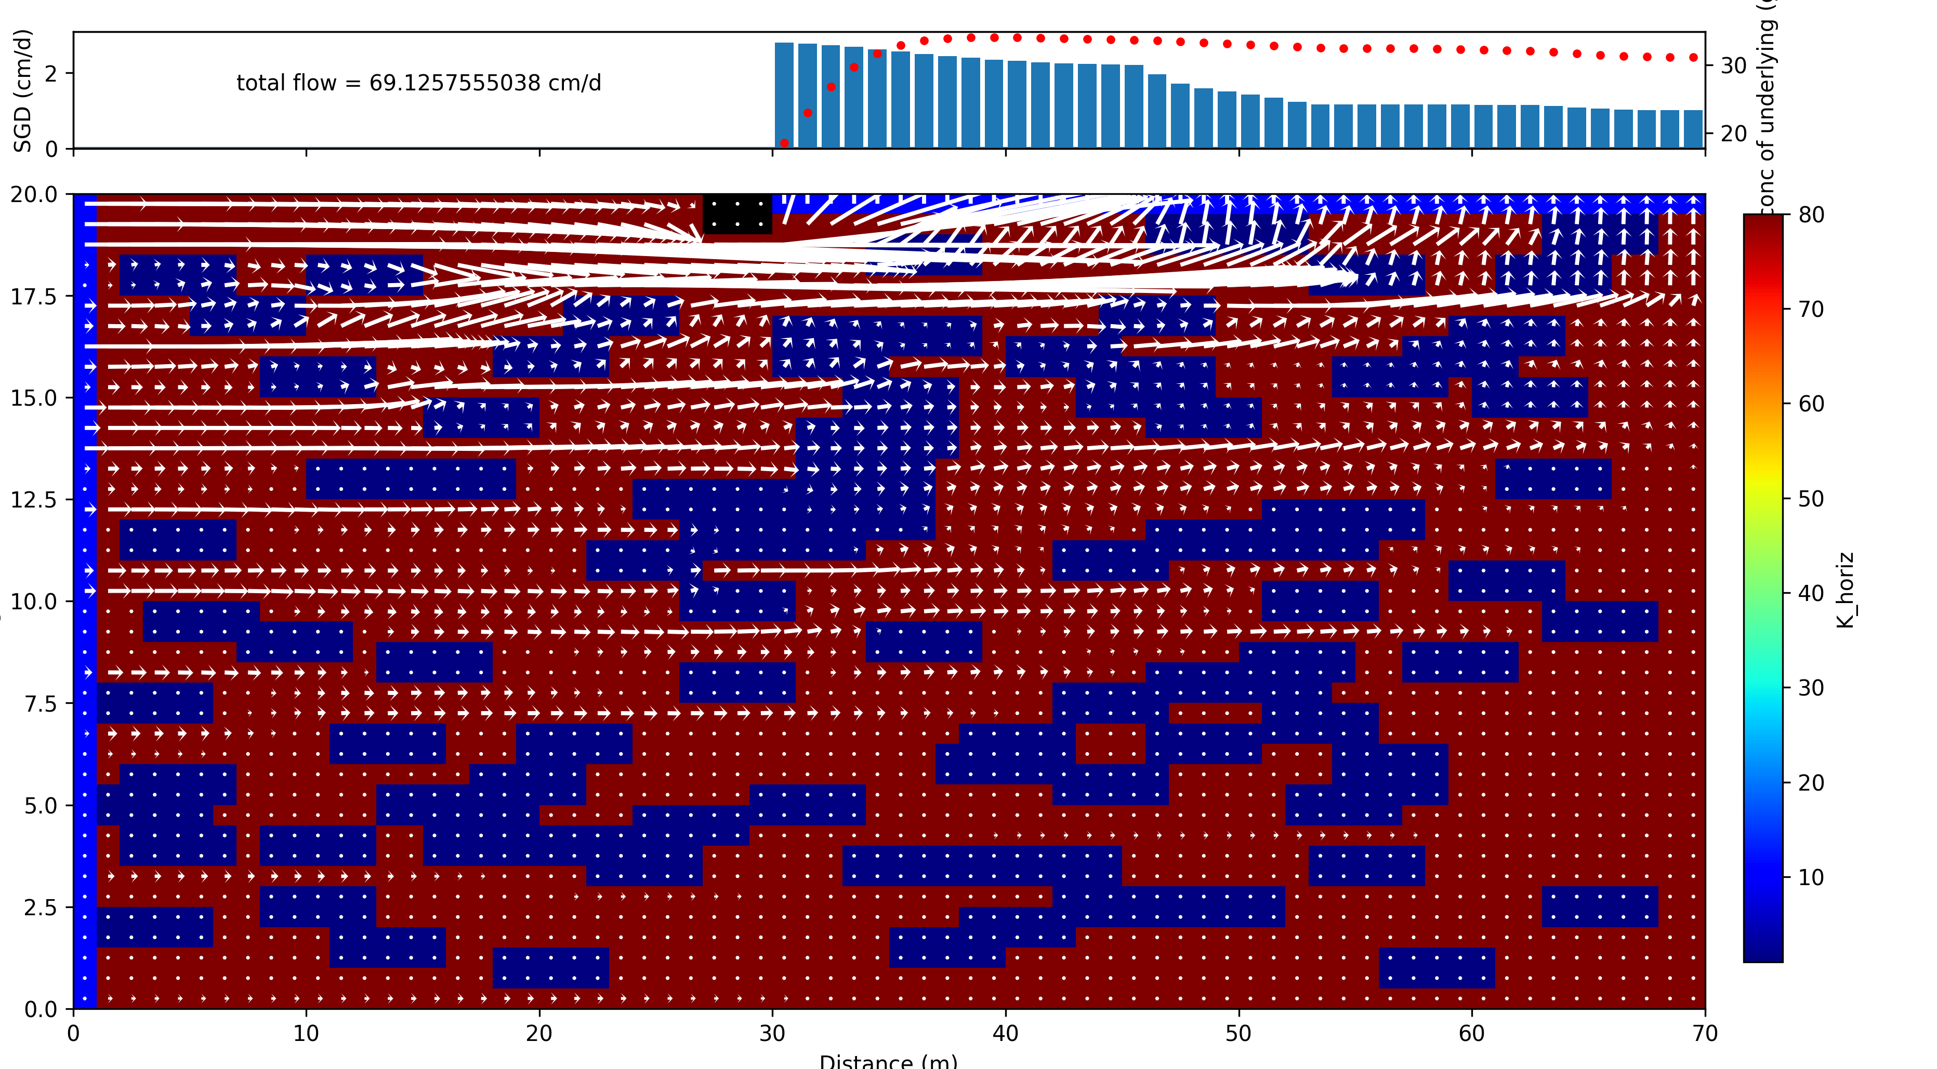
Model K field--heterogeneous

Slide 14
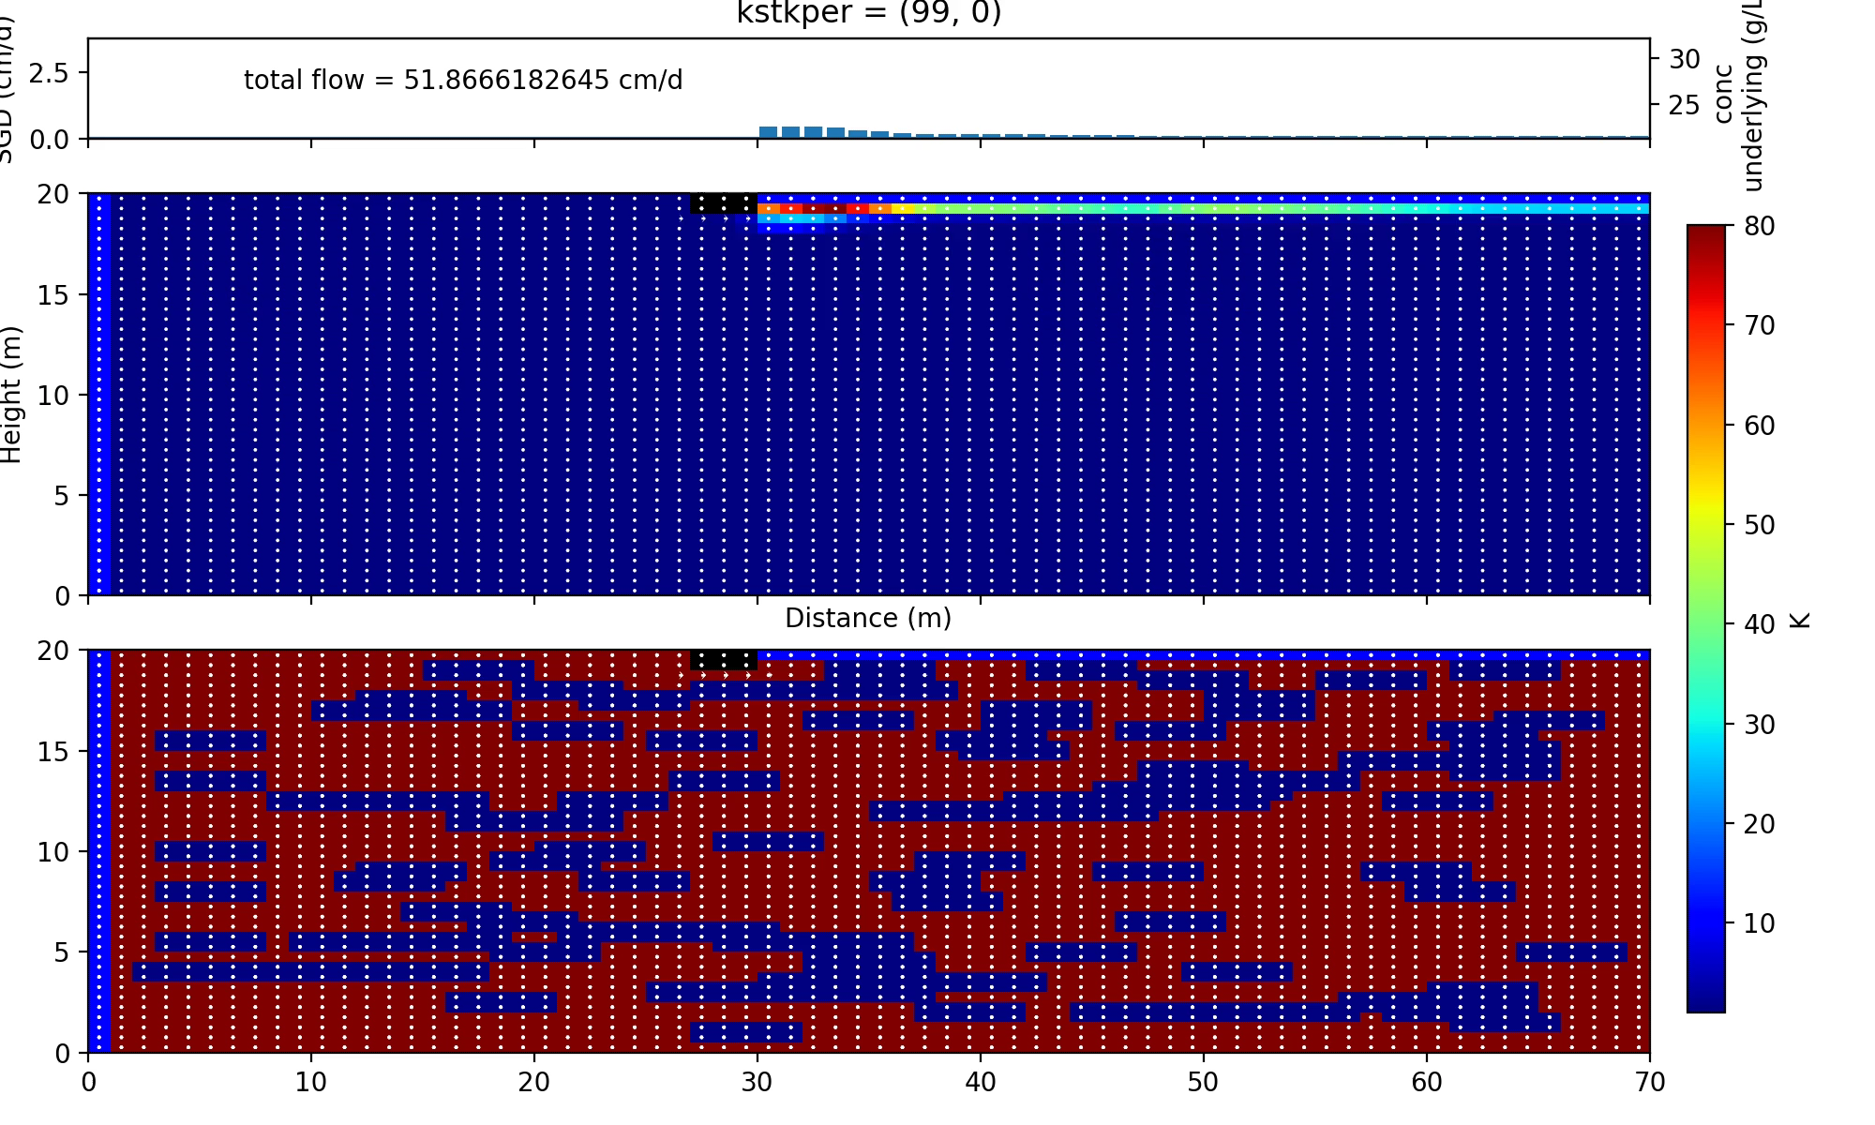
2D heterogeneous transient model: movie Model runs for 100 days

Slide 15
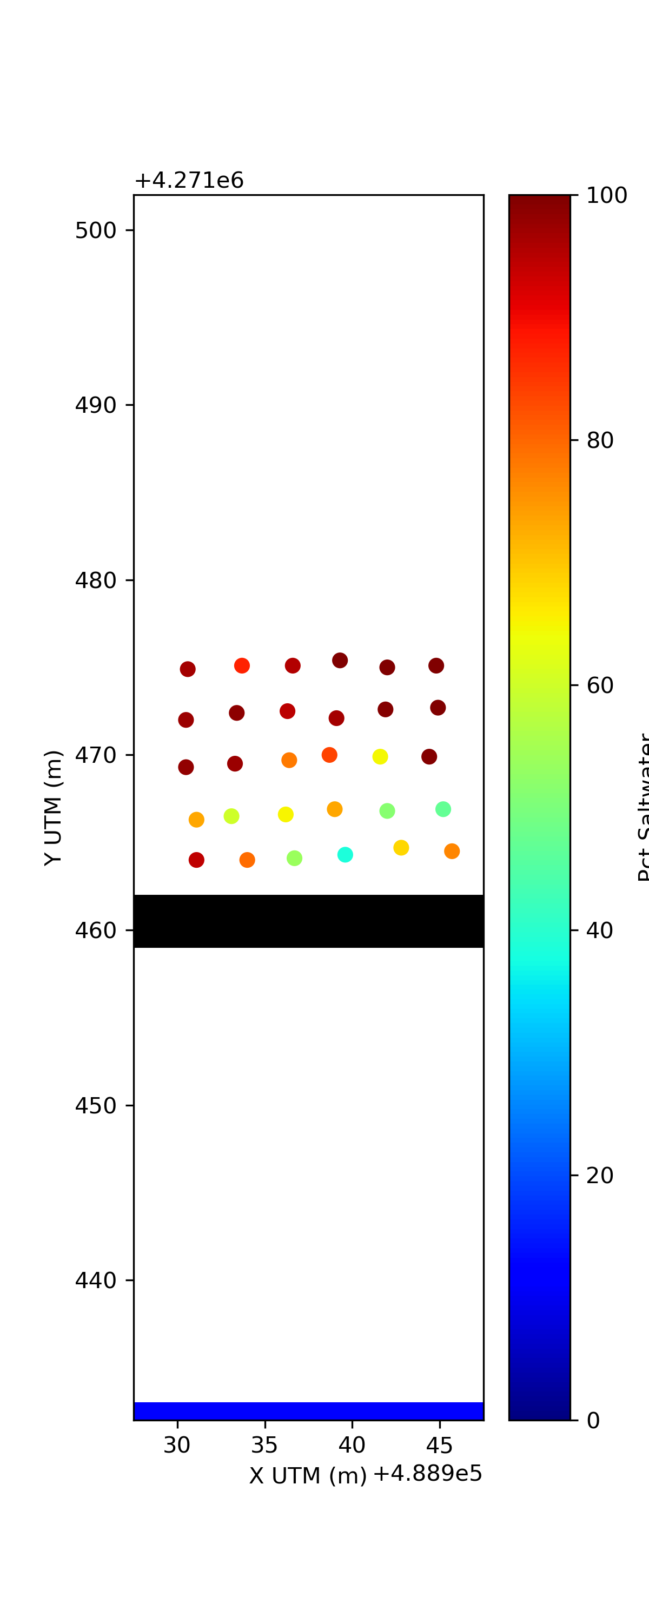
Reading in field data from Delaware
Model top view of second layer (beneath ocean floor)
Pct Saltwater

Slide 16
Reading in field data from Delaware
Model top view of second layer (beneath ocean floor)
Pct Saltwater
Field measurements from 2015 campaign
Model defined in UTM coords

Slide 17
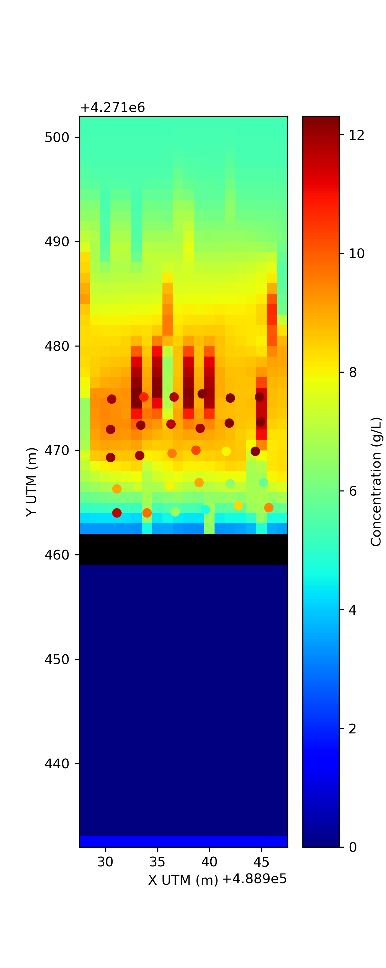
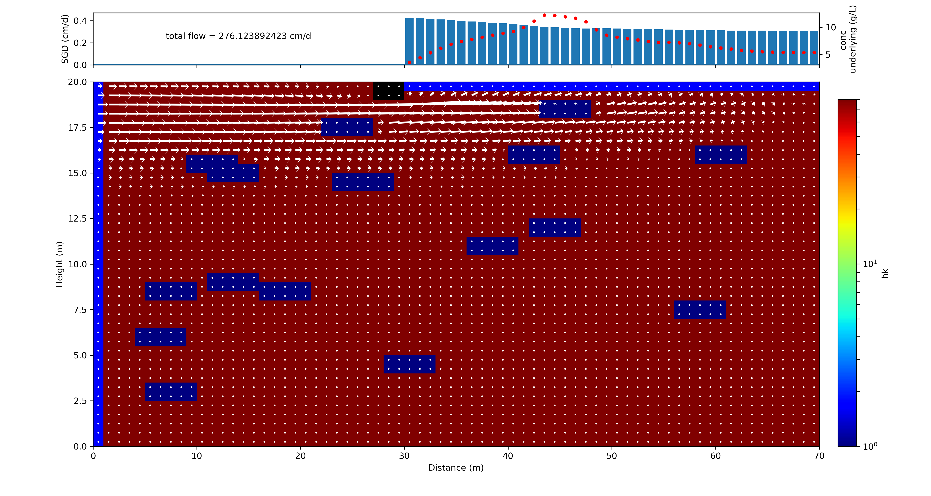
Results from 3D transient model run vs field data
Model top view of second layer (beneath ocean floor)
-Model 20 lay x 20 row x 70 col
-High conc streaks appear above near-surface clay blocks
Model cross-section: row 7
Row 7

Slide 18
PEST integration
Learned how to use PEST (took a while!)
Wrote scripts to write instruction file, template file, and control file for use with PEST
Currently just set up for optimizing K-field, but can add other aspects
Most (hyper)parameters and settings in PEST are simple
E.g. no regularization, no pilot points,…

Slide 19
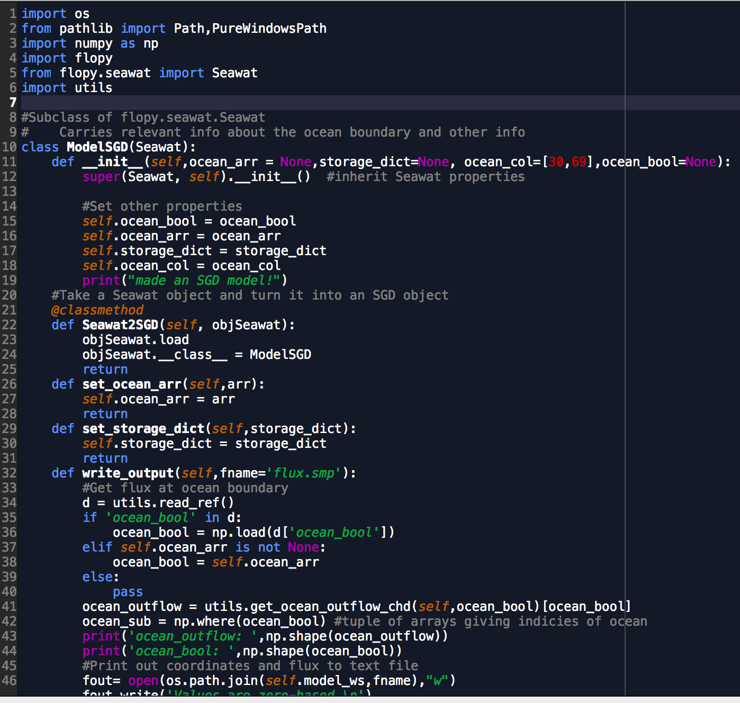
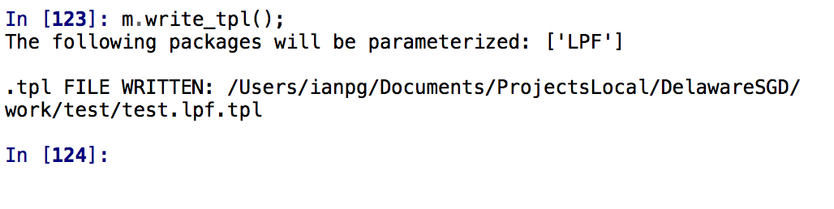
PEST integration
Scripts intended to be as object-oriented as possible. Created a “ModelSGD” class based on a FloPy Seawat class and contains relevant info about the SGD model
After defining the model “m”, can call methods to write PEST files before running PEST

Slide 20
Future implementations
K-field
Tie SGeMS into workflow
run an SGeMS simulation, export and read into flopy model
Boundary conditions
Start out with steady state, later might make simulations transient to include tides
Use field measurements in PEST optimization

Slide 21
Questions/problems with the model
Concentration field: numerical dispersion
Initial condition: freshwater-saturated or saltwater-saturated?
Boundary conditions: General head boundary condition at ocean?
Outflow concentration: which cells to use?
Outflow vs. concentration graphs don’t seem intuitive

Slide 22
Questions/problems with the model
PEST:
How to parameterize model for Pest?
Which parameters? K, porosity,…?
Each cell? Zones?
Suggestions for PEST hyperparameters & regularization?
Using Pilot points?

